Slide 1
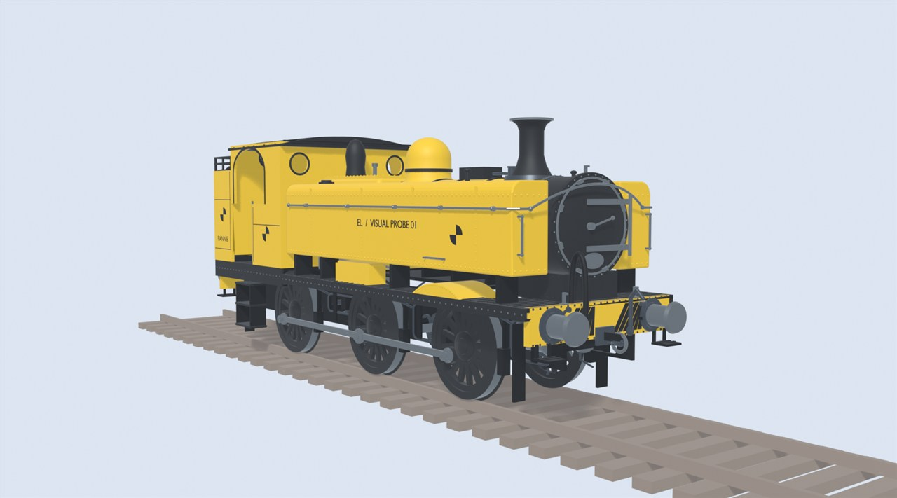
Early Locomotion
WELCOME
A steam railway mod for Satisfactory, explained for newcomers. Everything here is a plan, not a finished mod.
Early Locomotion project render. Early test model. Not final art.
1

Slide 2
How to read this guide
WELCOME
AGREED
Decided.
PROPOSED
Suggested, not confirmed.
PROVISIONAL
A test number that may change.
UNDECIDED
Still an open question.
BACKGROUND
A real-world fact.
Every idea carries a tag in the top-right corner.
2

Slide 3
The idea in one picture
WELCOME
AGREED
Cheap to build
Real limits:
speed, range, signals, stations
Your answers:
tenders, service stops, signal boxes
Later:
electric monorail
Early Locomotion project render. Early test model, not final art.
Cheap track and trains. Real limits. You solve them with coal, water, signals and planning.
3

Slide 4
What is Satisfactory?
THE GAME
BACKGROUND
Vanilla = the game without mods.
Belt
Miner
Smelter
Constructor
Storage
You
By Coffee Stain Studios. Full release 2024.
A first-person game about building factories. You mine, make and move materials until it all runs itself.
4

Slide 5
Where the mod fits
THE GAME
PROVISIONAL
Tier 6
Monorail: the game's electric trains
Tier 4 to 5
Heavy Steam
Tier 3 to 4
Railway Expansion
Tier 3
Early Steam Railways
Tiers and prerequisites:
PROVISIONAL
UNDECIDED (OQ01)
Technology unlocks in tiers. The mod adds steam railways early, before the game's electric trains.
5

Slide 6
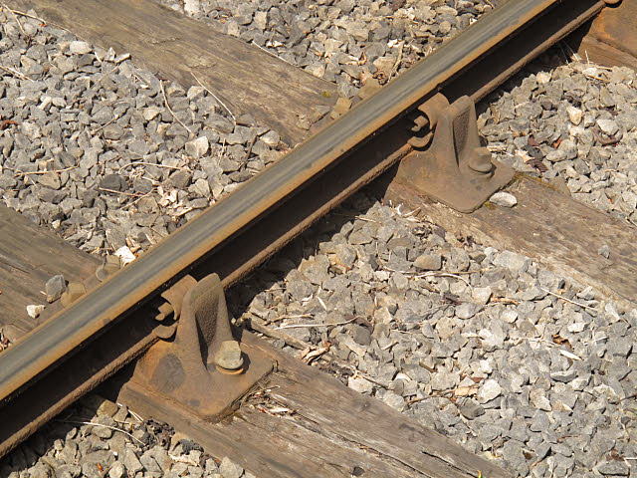
Track
STEAM RAILWAYS
BACKGROUND
Gauge: 1,435 mm on most railways
Rail
Sleeper
Photo: Stephen Craven, CC BY-SA 2.0, Wikimedia Commons.
Ballast
Two steel rails sit on sleepers over stone ballast. The sleepers keep the rails the right distance apart.
6

Slide 7
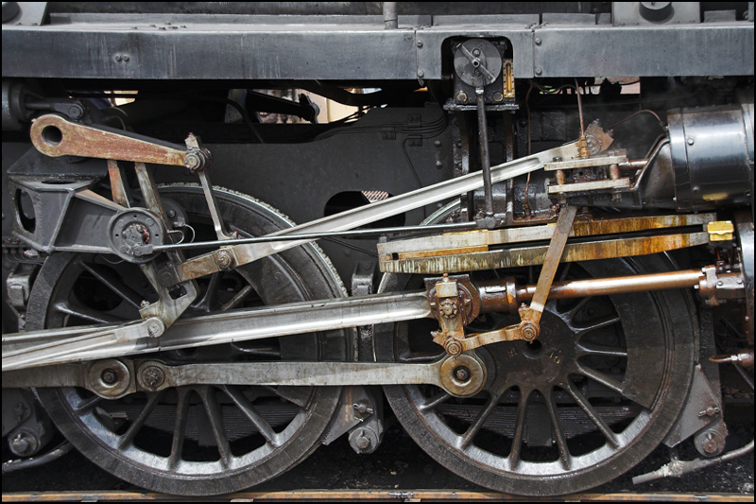
How a steam engine works
STEAM RAILWAYS
BACKGROUND
2
Steam
Exhaust
1
Fire
4
Wheels
3
Piston
Photo: Ben Salter, CC BY 2.0, Wikimedia Commons.
Coal heats water. Steam pushes pistons. Rods turn the wheels.
7

Slide 8
Coal, water and steam
STEAM RAILWAYS
AGREED
Before
After
Steam leaves the chimney. It is not used again.
One long trip
EMPTY FIRST
Coal
Water
Coal
Water
In the mod, water is usually the tighter limit.
AGREED
Steam is used once and lost. So water runs out first. Coal lasts longer.
8

Slide 9
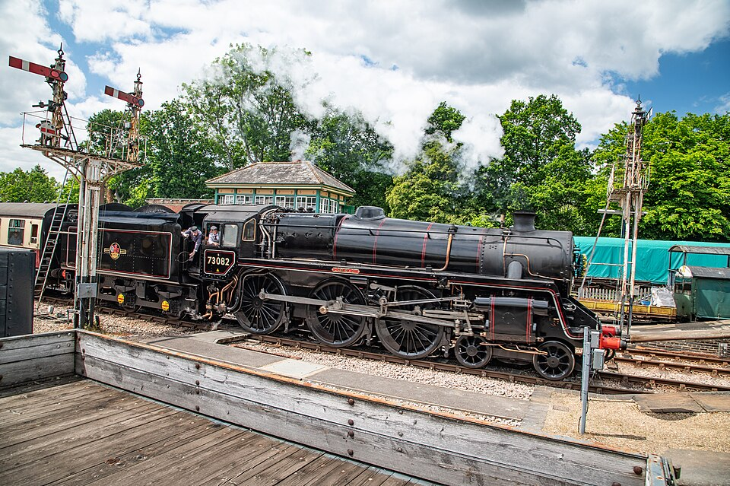
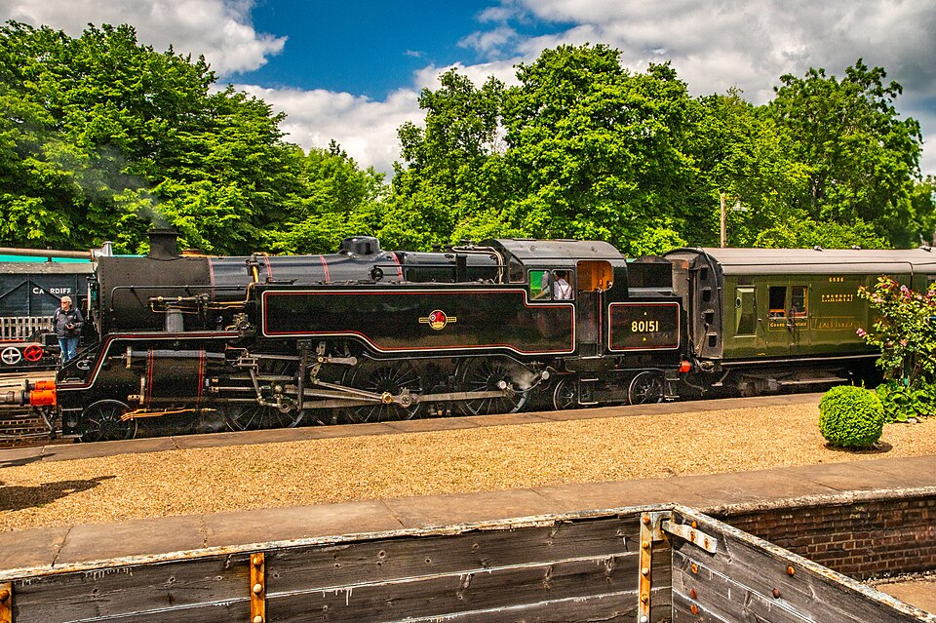
Tender or tank?
STEAM RAILWAYS
BACKGROUND
Tender engine
Tank engine
Tender: coal and water behind the cab
Side tanks: water.
Bunker: coal.
Photo: www.mgaylard.co.uk, CC BY 2.0, Wikimedia Commons.
Photo: www.mgaylard.co.uk, CC BY 2.0, Wikimedia Commons.
A tender engine pulls a coal and water wagon. A tank engine carries both itself.
9

Slide 10
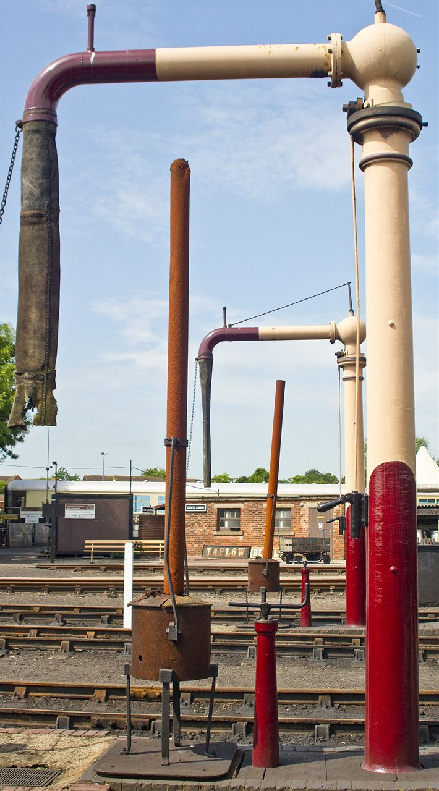
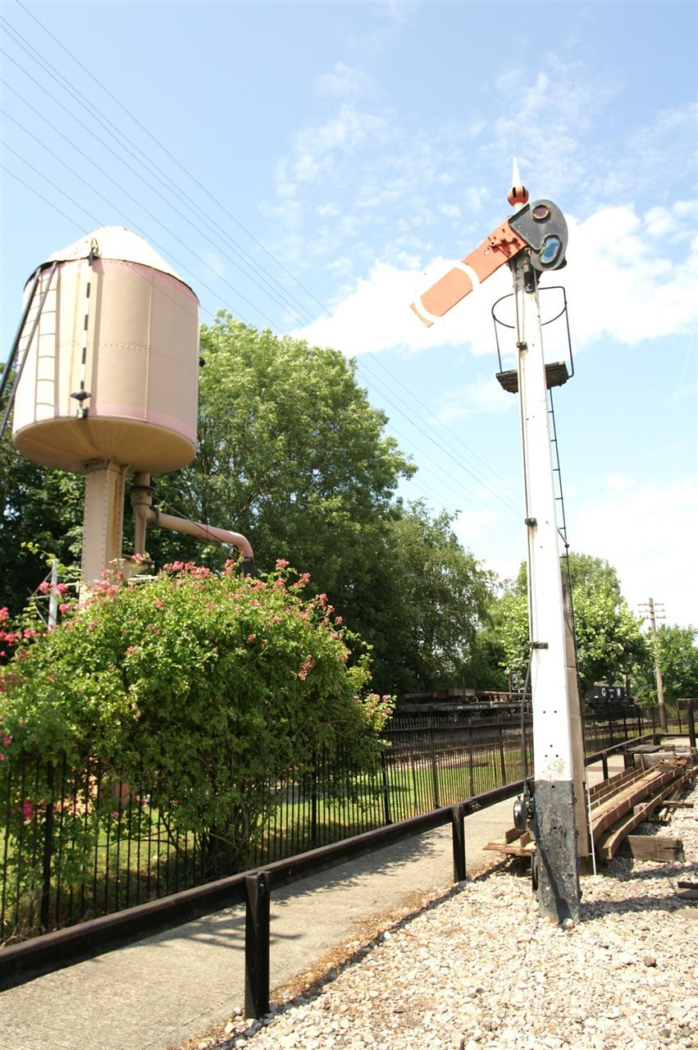
Taking on water
STEAM RAILWAYS
BACKGROUND
Arm swings over the hatch
Gravity
Photo: David Merrett, CC BY 2.0, Wikimedia Commons.
Photo: Barry Skeates, CC BY 2.0, Wikimedia Commons.
A water crane swings over the engine. Water flows down from a tank above.
10

Slide 11
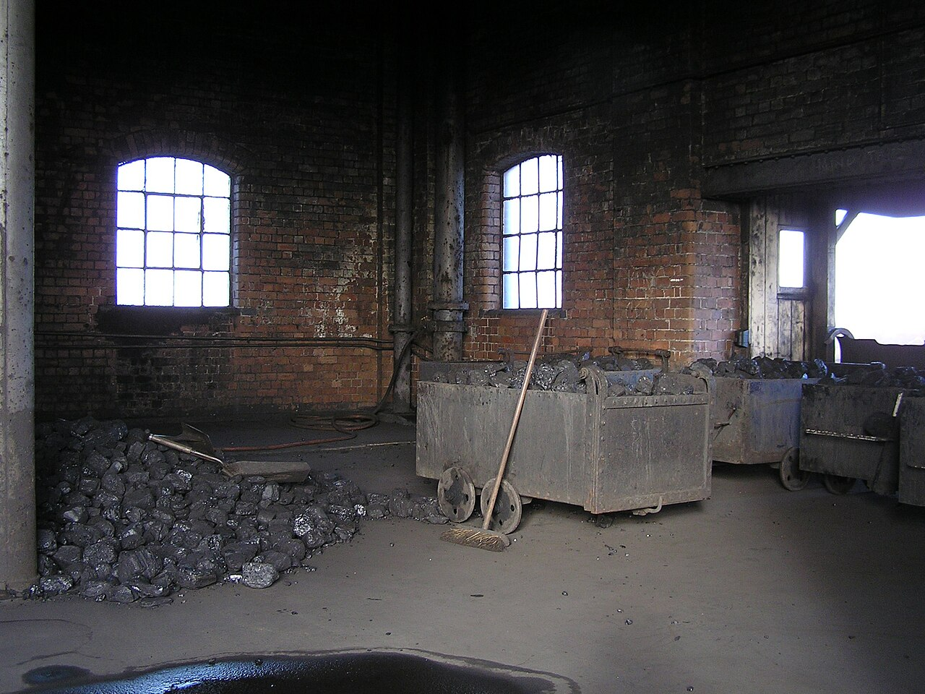
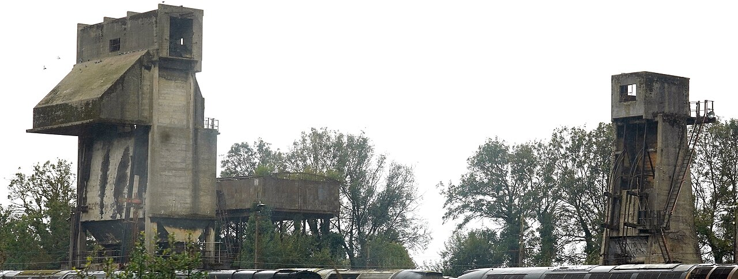
Taking on coal
STEAM RAILWAYS
BACKGROUND
Coal stage
Gravity
Coaling tower
Photo: Gillett's Crossing, CC BY 2.0, Wikimedia Commons.
Gravity
Photo: kitmasterbloke, CC BY 4.0, Wikimedia Commons.
Coal starts higher than the tender. A ramp or tower lets gravity fill it.
11

Slide 12
Why trains need signals
STEAM RAILWAYS
BACKGROUND
No warning: crash
STOP
CLEAR
Long stopping distance
Block 1
Block 2
Block 3
Trains cannot swerve. They need a long way to stop. Signals keep them apart.
12

Slide 13
Words you will meet
STEAM RAILWAYS
BACKGROUND
Vanilla
The game without mods.
Tier
A step of unlocks.
Wagon
A vehicle that carries cargo.
Tender
A coal and water wagon behind an engine.
Block
A stretch of track that holds one train.
Semaphore
A signal with a moving arm.
Signal box
Where a signaller works the signals.
Service stop
A stop to refill coal and water.
Short meanings for the words in this guide.
13

Slide 14
Not "trains, but earlier"
THE MOD'S IDEA
AGREED
Vanilla electric (later)
Early steam (this mod)
Monorail beam
Two-rail track
Electricity
Coal and water
No refuelling
Service stops
Block and path
Semaphores and boxes
Compact
Large
Steam rail is not electric trains with an early unlock. It works in its own way.
14

Slide 15
Every limit has an answer
THE MOD'S IDEA
AGREED
Auxiliary tender
Short range
Service stop
Bigger engine
Small loads
A suitable engine and train length
Busy line
More signals and boxes
Slow overall
Convert to monorail later
Short range, small loads, a busy line, slow trips: each has a fix.
15

Slide 16
Why steam stays behind electric
THE MOD'S IDEA
AGREED
Cheap to start
Steam
Electric
Speed
Steam gets there first. Electric wins when the network matures.
Throughput
Traffic density
Convenience
Shape only. Not measured.
Steam is cheap and early. Electric wins on speed, throughput, traffic and convenience.
16

Slide 17
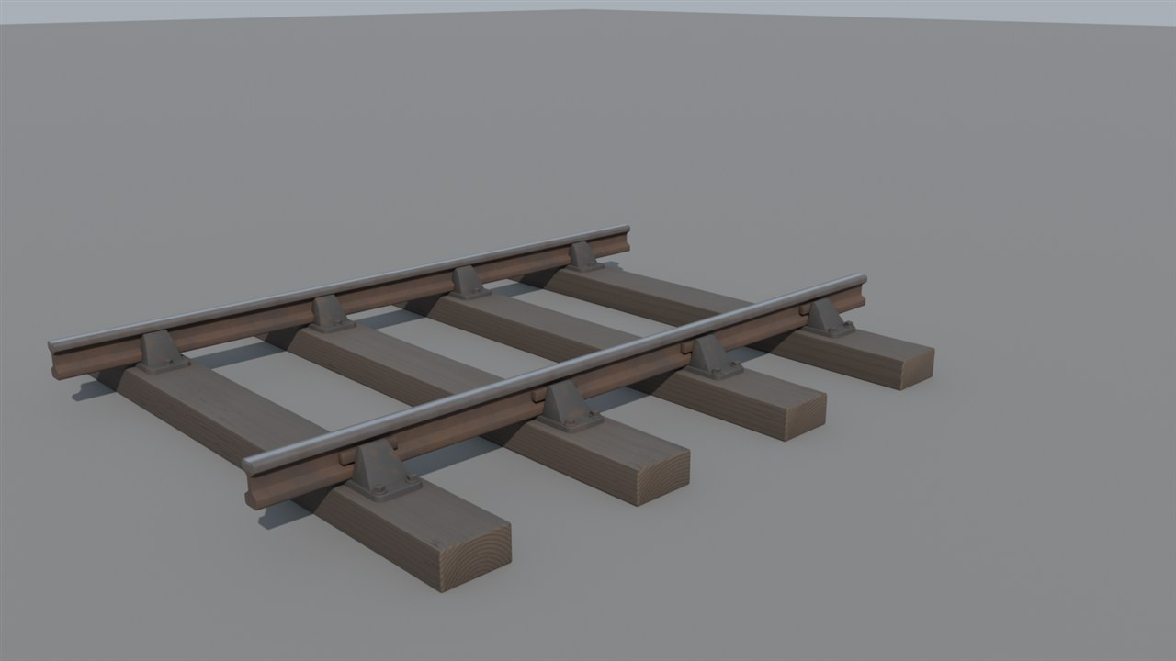
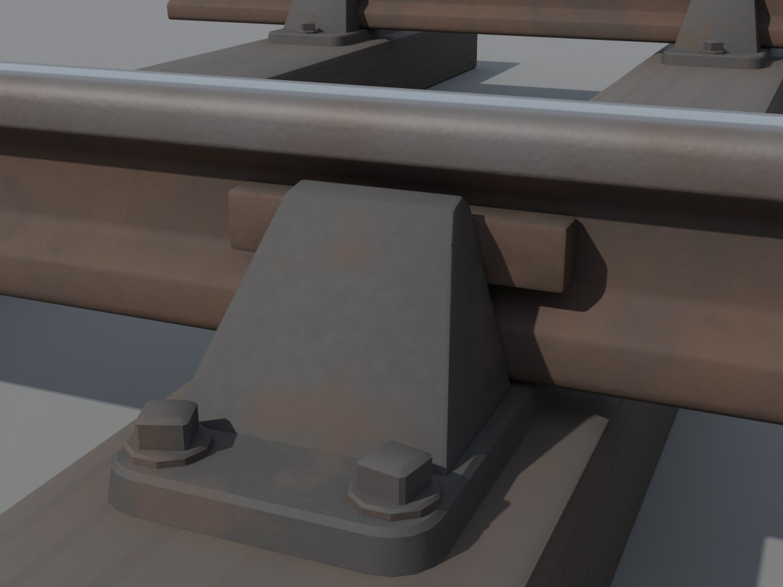
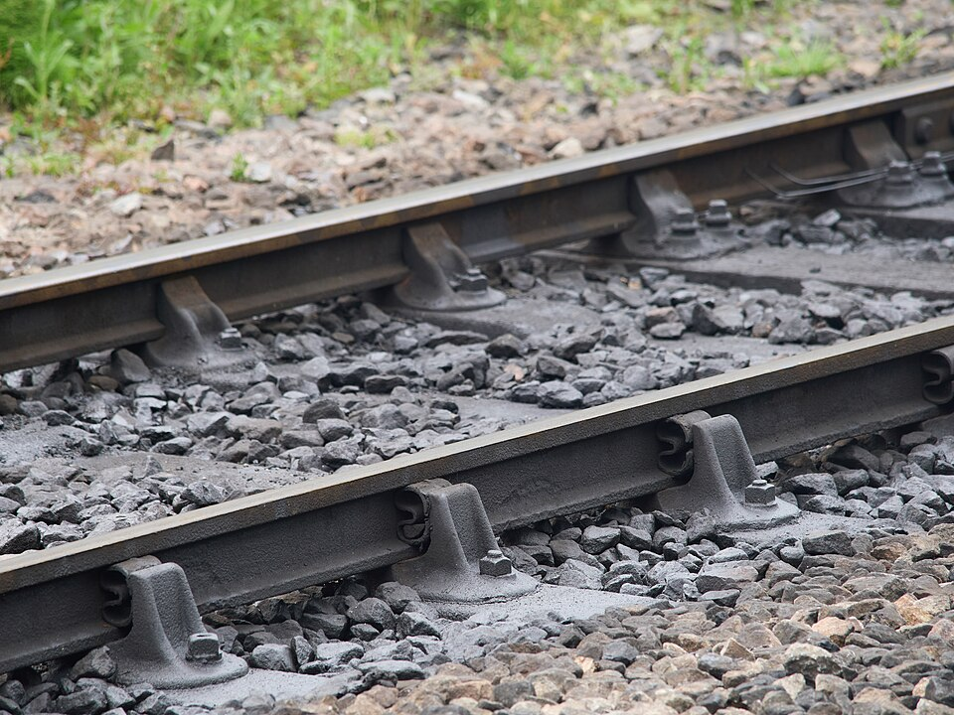
The mod's track
THE MOD'S IDEA
AGREED
Early Locomotion project render. Early test model, not final art.
Close-up: chairs and rails
Photo: James E. Petts, CC BY-SA 4.0, Wikimedia Commons.
Early Locomotion project render. Early test model, not final art.
Real railway, for comparison
Speed = lowest of: track limit, signal limit, engine limit
PROPOSED
Longest track piece:
UNDECIDED (OQ02)
Two thin rails on sleepers, built from iron plates and rods. Speed is the lowest of three limits.
17

Slide 18
Three roles
LOCOMOTIVES
AGREED
Small
Medium
Large
Haul
Haul
Haul
Speed
FASTEST? UNDECIDED
Speed
Speed
Range
Range
Range
Servicing needs
Servicing needs
Servicing needs
Local branches
Fast mixed freight
Heavy freight
Shape only. Not measured.
Small, Medium and Large each have a job. Bigger is not simply better.
18

Slide 19
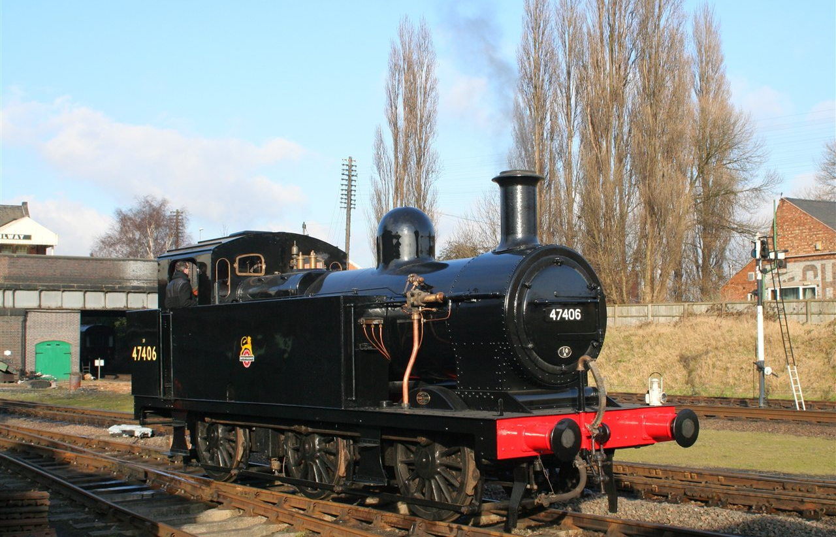
Small: the branch-line tank
LOCOMOTIVES
AGREED
No tender
Weakest hauler
Cheap to run
Struggles with long trains and hills
PROPOSED
Photo: Duncan Harris, CC BY-SA 2.0, Wikimedia Commons.
A related Fowler tank engine (a Jinty). The design's reference, the Dock Tank, has no survivor.
Small carries its own coal and water. It is cheap, light and best on short branches.
19

Slide 20
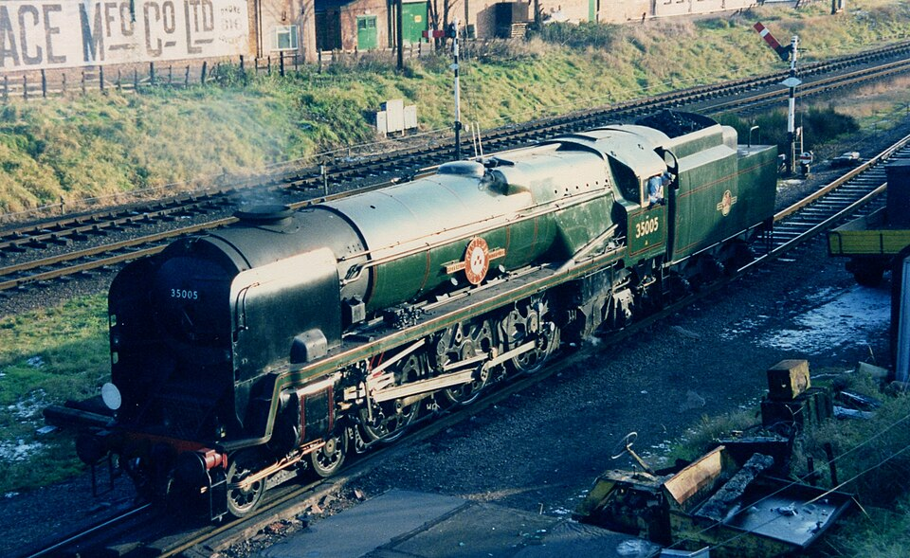
Medium: the long-range runner
LOCOMOTIVES
AGREED
Normal tender: more coal and water
Burns more
Auxiliary tender: a practical extra
Fastest class
Photo: kitmasterbloke, CC BY 2.0, Wikimedia Commons.
PROPOSED
UNDECIDED (OQ05)
Reference: Merchant Navy class
Medium has a tender and more range. It uses more coal and water. It may be the fastest class.
20

Slide 21
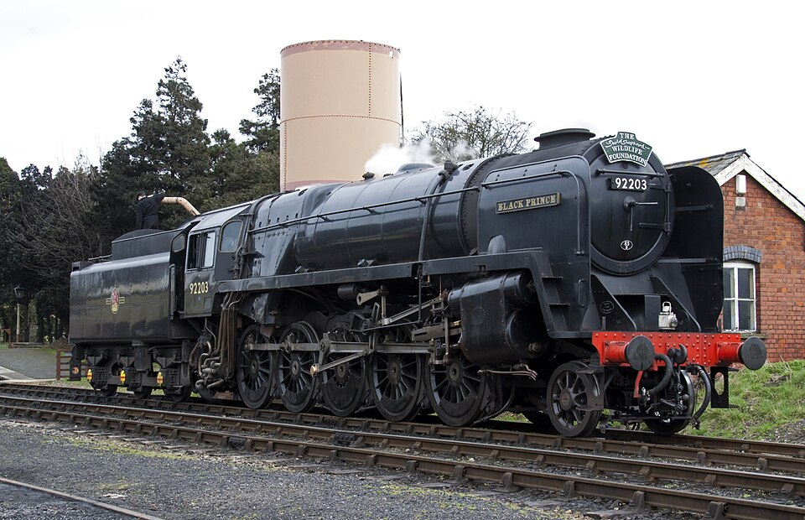
Large: the heavy hauler
LOCOMOTIVES
AGREED
Most powerful
High coal and water demand
Auxiliary tender for very long routes
Slower to speed up
PROPOSED
Photo: Tony Hisgett, CC BY 2.0, Wikimedia Commons.
Reference: BR Standard 9F
Large pulls the heaviest trains. It is thirsty and slow to speed up. It suits heavy freight.
21

Slide 22
Wagons
LOCOMOTIVES
PROVISIONAL
Steam wagon: about 20 stacks
Vanilla wagon: 32 stacks
PROVISIONAL
Stack = a pile of one item.
Wagon catalogue:
UNDECIDED
Steam wagons are cheaper and hold less. About 20 item stacks, against 32 in a vanilla wagon.
22

Slide 23
How far can an engine go?
LOCOMOTIVES
AGREED
Route-dependent targets
PROVISIONAL
Range left
 | Water (km) | Coal (km)
Small | 2–3 | 4–5
Medium | 4–5 | about 7
Large | 6–7 | about 10
Compacted Coal burns more efficiently.
AGREED DIRECTION
AGREED
Range comes from real tank sizes and real use. Hills and heavy loads use more. Coasting uses less.
23

Slide 24
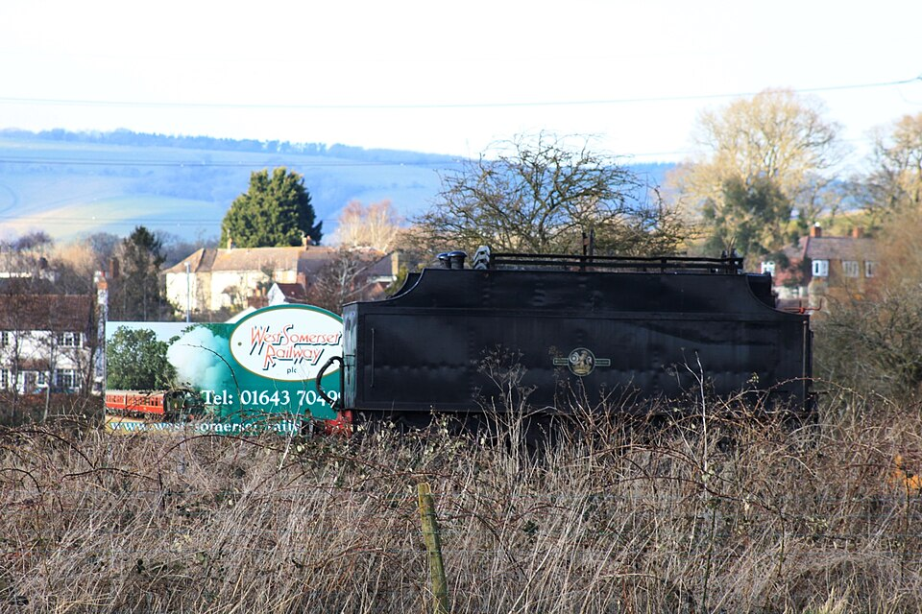
Tenders
LOCOMOTIVES
AGREED
A real tender, for illustration
One vehicle
Auxiliary tender: a separate wagon
PROPOSED
WATER ONLY
COAL AND WATER
Carries no freight
Adds weight
Photo: Geof Sheppard, CC BY-SA 4.0, Wikimedia Commons.
A normal tender belongs to the engine. An auxiliary tender is an extra wagon: more range, less pulling power.
24

Slide 25
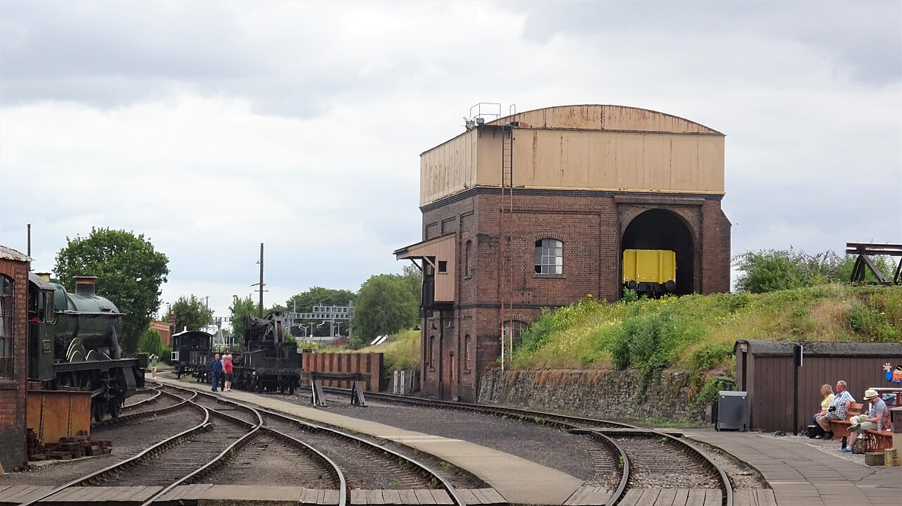
A steam station
STATIONS
AGREED
Pipe: water in
Photo: Rosser1954, CC BY-SA 4.0, Wikimedia Commons.
Conveyor: coal in
Coal bunker
Water hatch
Platform and cargo loading
Signal box
Vanilla station (for comparison)
Large footprint. Exact size undecided.
A steam station is big. It has a water tower, coal loading, a signal box and a platform.
25

Slide 26
Servicing takes time
STATIONS
AGREED
1
2
3
4
5
Approach slowly
Settle into dock
Long steam hiss
Coal chutes in
Water arm swings
PROPOSED
9
8
7
6
Depart
Folds away
Wait while it fills
Finds the hatches
Empty tanks
Rates and times:
Small top-up
PROPOSED
PROVISIONAL
The machinery finds each engine's hatches. Servicing takes visible time. Then it folds away.
26

Slide 27
Service points
STATIONS
PROPOSED
PROPOSED
PROPOSED
PROPOSED
PROPOSED
Water Tower
Coaling Stage
Steam Service Point
Full Station
Mine
Water stop
Water and coal stop
Factory
Separate coal and water stops make long routes possible. Not every stop needs a full station.
AGREED
27

Slide 28
Blocks: one train at a time
SIGNALS
AGREED
One block
Waits
STOP
CLEAR
CLEAR
Block A: occupied
Block B: occupied
Block C: free
Block D: free
Arm flat: stop
Arm raised: go
Signals split the track into blocks. Only one train may be in a block. The next train waits.
28

Slide 29
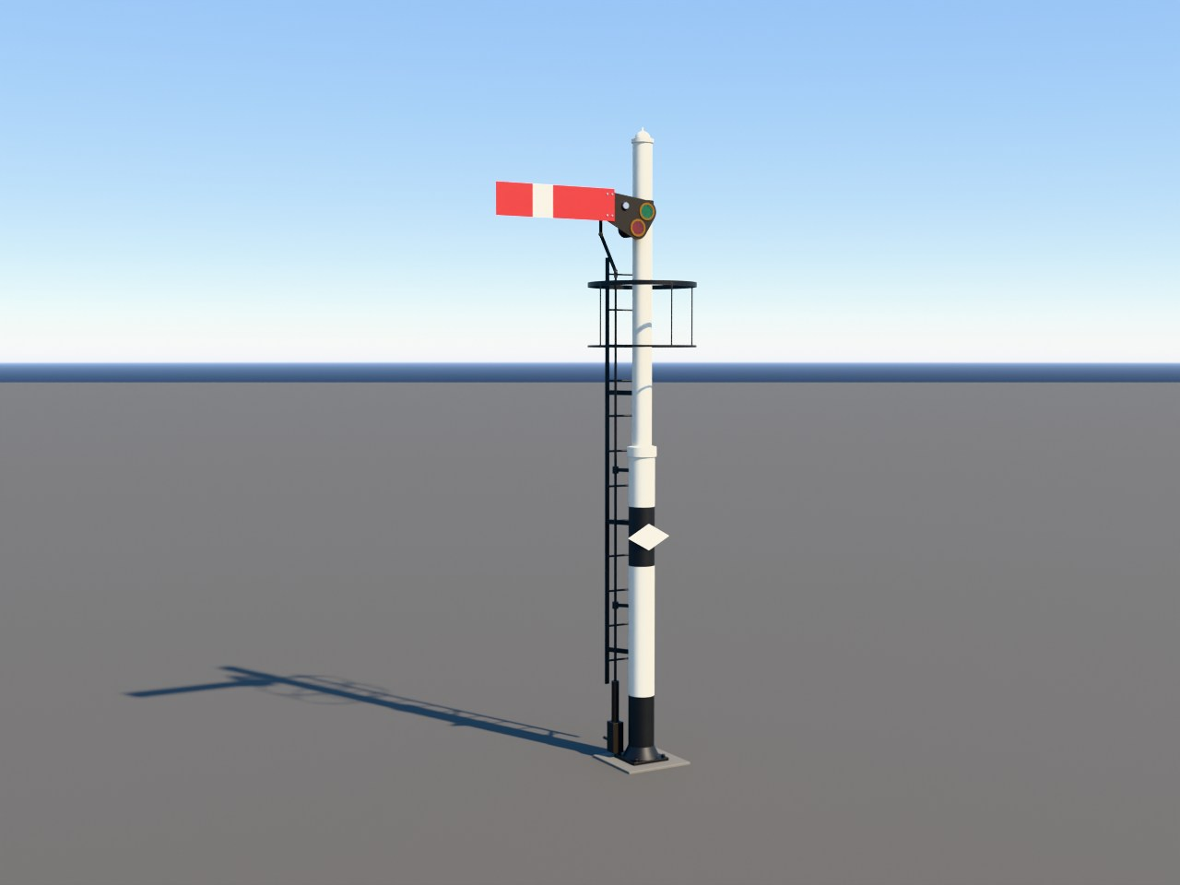
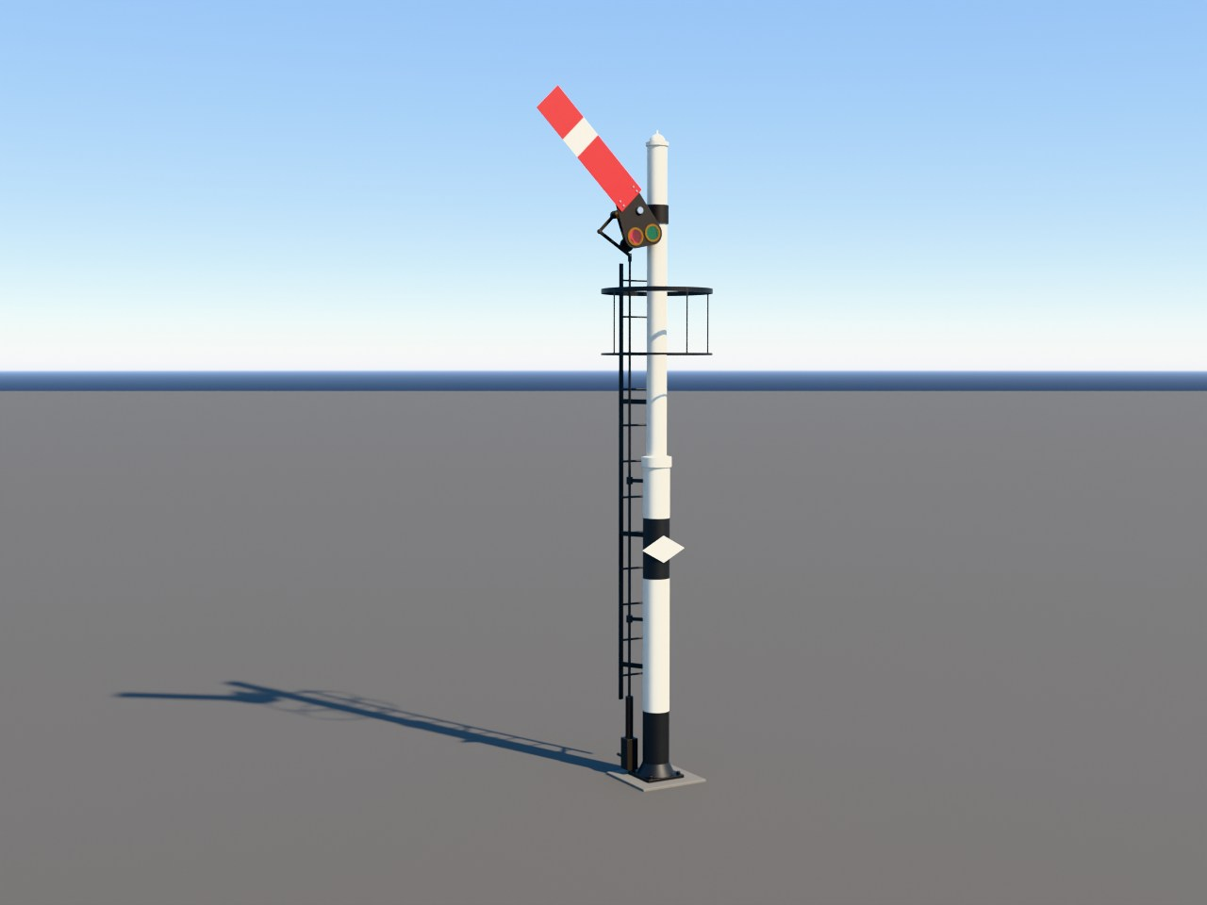
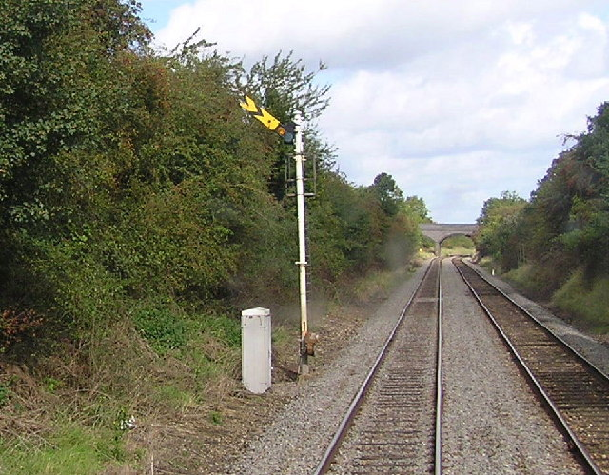
Semaphore signals
SIGNALS
AGREED
ARM STYLE: UNDECIDED
Distant signal
STOP: arm flat
CLEAR:
arm raised
Be ready to stop at the next signal
Next signal is clear
Early Locomotion project render. Early test model, not final art.
Blender model, not yet in the game.
Early Locomotion project render. Early test model, not final art.
Blender model, not yet in the game.
Photo: Richard Dunn, CC BY-SA 2.0, Wikimedia Commons.
Arm flat means stop. Arm raised means go. On real railways, a broken wire drops the arm to stop.
29

Slide 30
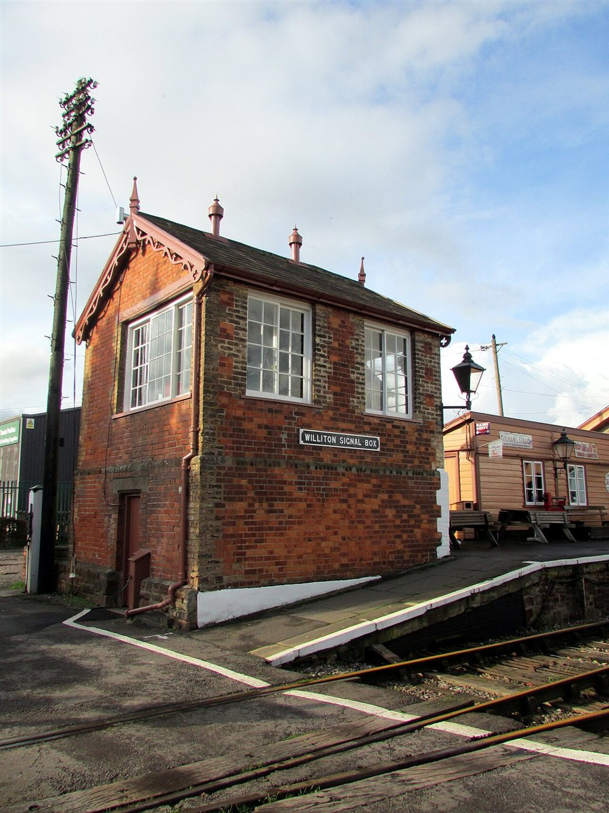
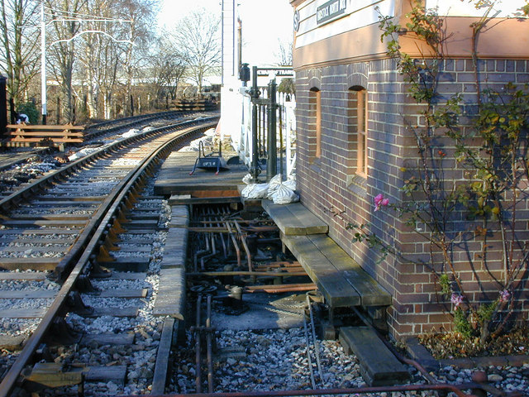
The signal box
SIGNALS
AGREED
Operating floor
Levers are locked so two clashing signals cannot both be clear
Example colours only
Stop
Distant
Points
Lock
Locking room
Rods and wires run out to signals and points
Photo: Nigel Brown, CC BY-SA 2.0, Wikimedia Commons.
Photo: Reading Tom, CC BY 2.0, Wikimedia Commons.
A signaller pulls levers. Rods and wires carry the movement out to the signals.
30

Slide 31
How it works together
SIGNALS
AGREED
Bell codes
Box territory: limited
STOP
CLEAR
CLEAR
Block 1
Block 2
Block 3
1
Train in block
2
Signal at STOP
3
Train leaves
4
Lever pulled: arm lifts
In the mod: no player wiring.
AGREED
The signaller watches the blocks, sets the signals and keeps trains apart.
31

Slide 32
Early limits
SIGNALS
PROVISIONAL
Block length
Speed cap
Signals per box
Box reach
about 400 to 500 m
about 60 km/h
6 to 8 (station box), 12 to 16 (dedicated box)
about 1 to 1.5 km of track
PROVISIONAL
PROVISIONAL
PROVISIONAL
PROVISIONAL
0 m
450 m
900 m
1,350 m
1,800 m
2,250 m
Block lengths and speed caps:
UNDECIDED (OQ03)
Early signals have limits: short blocks, a speed cap and a limited number per box. Numbers are provisional.
32

Slide 33
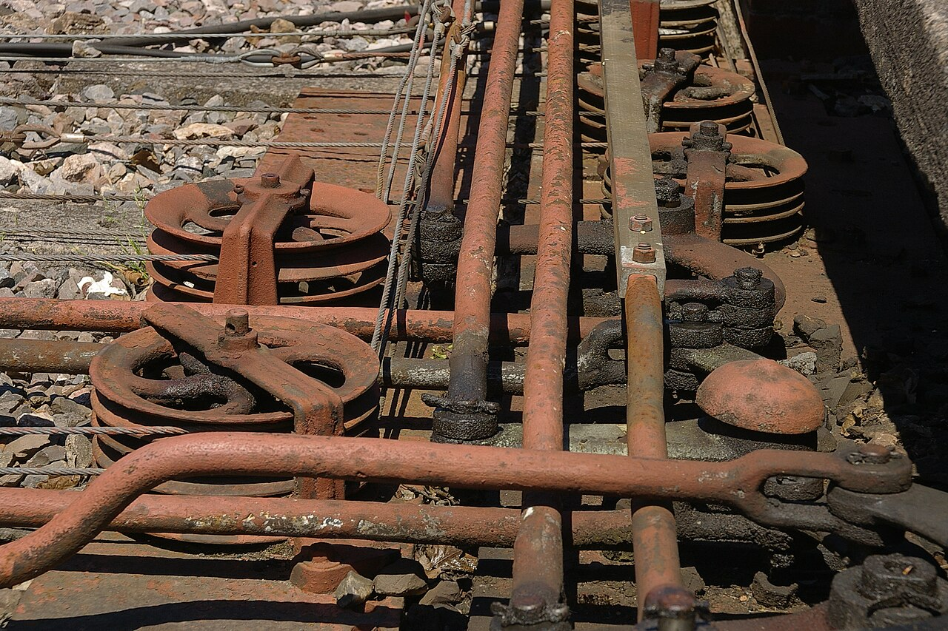
No wiring for you
SIGNALS
AGREED
ROD OR WIRE LOOK: UNDECIDED (OQ04)
Place signals on connected track
1
A box with room takes control
2
Rods and wires draw themselves
3
Box screen: signals, state, capacity, reach.
Photo: mattbuck (category), CC BY-SA 3.0, Wikimedia Commons.
Boxes take control of connected signals automatically. Rods and wires are drawn for you, as a visual layer.
33

Slide 34
Later signals and manual control
SIGNALS
AGREED
Start: semaphore blocks
AUTO
YARD
MAINLINE
AGREED
Later: better semaphore or interlocking
PROPOSED
Mature: electronic signals like vanilla
PROPOSED
Pick a destination and let the game set points:
PROPOSED
Better signals come later. Drivers can also set points from a simple track diagram.
34

Slide 35
Upgrading to the monorail
LATER
AGREED
Before
Upgrade
PROPOSED
Mixed network
PROPOSED
Steam trains cannot use this section
Interchange
(possible Transfer Station: undecided)
Steam trains cannot move directly between the two track types.
AGREED
Upgrade steam track in place. The route stays. Steam trains cannot use the converted part.
35

Slide 36
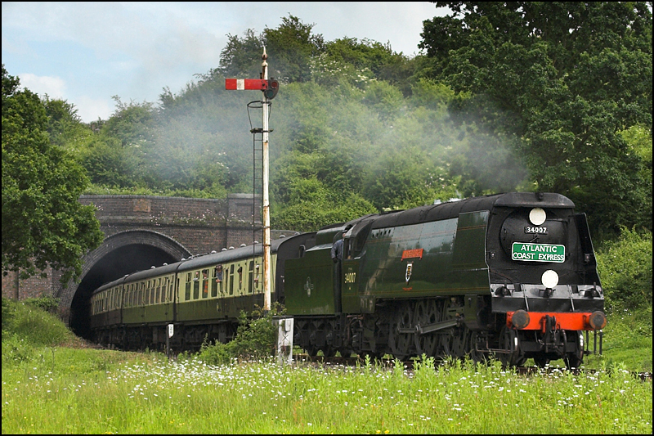
After launch
LATER
PROPOSED
PROPOSED
PROPOSED
Late-steam infrastructure
Advanced manual driving (optional)
PROPOSED
PROPOSED
Regional packs
More locomotives
Core 1.0: a complete game
Photo: Ben Salter, CC BY 2.0, Wikimedia Commons.
AGREED
Real British locomotives like this could appear.
Which locomotives:
UNDECIDED (OQ20)
After launch, optional packs could add locomotives, regional looks and deeper driving. The core game stays complete.
36

Slide 37
Regions and running numbers
EXTRAS
AGREED
British
No. 1234
North American
Continental European
Visible number
Examples only. Launch regions:
Fleet ID: hidden, never changes
UNDECIDED (OQ06)
Changing region restyles Core stock. Migration:
UNDECIDED
The world picks a regional style. Each engine has a hidden permanent ID and a number you can change.
37

Slide 38
Your railway guide
EXTRAS
AGREED
Short caption here
PROPOSED
A playful takeover when you first unlock rail
A friendly railway guide teaches with short animated lessons. Lessons are optional and can be replayed.
38

Slide 39
Where we are
STATUS
PROVISIONAL
Plans can change.
PROVISIONAL
Under way
Early Locomotion project render. Early test model, not final art.
Early Locomotion project render. Early test model, not final art.
Planned
Engine
Rolling stock
Track
Stations
Signals
Unlocks
Tutorials
Release 1.0: singleplayer
Later: multiplayer
A test engine runs on the game's real rails. Next come the other railway pieces. Singleplayer first. Multiplayer after release.
39

Slide 40
Still undecided
STATUS
UNDECIDED
UNDECIDED
UNDECIDED
UNDECIDED
UNDECIDED
Exact unlock tiers (OQ01)
Longest track piece (OQ02)
Block lengths and speed caps (OQ03)
How boxes measure their reach (OQ04)
UNDECIDED
UNDECIDED
UNDECIDED
UNDECIDED
Is Medium the fastest? (OQ05)
Which regions at launch? (OQ06)
Which extra locomotives? (OQ20)
Pricing and release of packs (OQ26)
These questions are open. Nothing here has been chosen yet.
40

Slide 41
Image credits (1 of 2)
CREDITS
Slot | Slide | Author | Licence | Source
P01 | 6 | Stephen Craven | CC BY-SA 2.0 | Wikimedia Commons
P02 | 17 | James E. Petts | CC BY-SA 4.0 | Wikimedia Commons
P03 | 7 | Ben Salter | CC BY 2.0 | Wikimedia Commons
P04 | 9 | www.mgaylard.co.uk | CC BY 2.0 | Wikimedia Commons
P05 | 9 | www.mgaylard.co.uk | CC BY 2.0 | Wikimedia Commons
P06 | 10 | Barry Skeates | CC BY 2.0 | Wikimedia Commons
P07 | 10 | David Merrett | CC BY 2.0 | Wikimedia Commons
P08 | 11 | Gillett's Crossing | CC BY 2.0 | Wikimedia Commons
P09 | 11 | kitmasterbloke | CC BY 4.0 | Wikimedia Commons
P10 | 19 | Duncan Harris | CC BY-SA 2.0 | Wikimedia Commons
P11 | 20 | kitmasterbloke | CC BY 2.0 | Wikimedia Commons
P12 | 21 | Tony Hisgett | CC BY 2.0 | Wikimedia Commons
CC BY-SA photos are shown unmodified except for resizing.
Photographs come from Wikimedia Commons under Creative Commons licences.
41

Slide 42
Image credits (2 of 2)
CREDITS
Slot | Slide | Author | Licence | Source
P13 | 29 | Richard Dunn | CC BY-SA 2.0 | Wikimedia Commons
P14 | 30 | Reading Tom | CC BY 2.0 | Wikimedia Commons
P15 | 30 | Nigel Brown | CC BY-SA 2.0 | Wikimedia Commons
P16 | 33 | mattbuck (category) | CC BY-SA 3.0 | Wikimedia Commons
P17 | 25 | Rosser1954 | CC BY-SA 4.0 | Wikimedia Commons
P18 | 24 | Geof Sheppard | CC BY-SA 4.0 | Wikimedia Commons
P19 | 36 | Ben Salter | CC BY 2.0 | Wikimedia Commons
R01 | 1, 3, 39 | Early Locomotion project (test model, not final art) | No third-party licence | Project render
R02 | 17, 39 | Early Locomotion project (test model, not final art) | No third-party licence | Project render
R03 | 29 | Early Locomotion project (test model, not final art) | No third-party licence | Project render
R04 | 29 | Early Locomotion project (test model, not final art) | No third-party licence | Project render
R05 | 17 | Early Locomotion project (test model, not final art) | No third-party licence | Project render
CC BY-SA photos are shown unmodified except for resizing.
Mod renders belong to the project. They show early test models.
42

Slide 43
Signals and Signal Boxes
Early Locomotion: a mod for Satisfactory
How steam railways keep trains apart, and how the mod plans to do it.
Early Locomotion project render. Blender model, not yet in the game.

Slide 44
How to read this guide
Decided.
AGREED
Suggested, not confirmed.
PROPOSED
A test number that may change.
PROVISIONAL
Still an open question.
UNDECIDED
A real-world fact.
BACKGROUND
Every idea carries a tag in the top-right corner.
2

Slide 45
The problem
BACKGROUND
No warning: crash
Long stopping distance
How far the driver can see
Trains cannot swerve. They need a long way to stop. Signals keep them apart.
3

Slide 46
Blocks
BACKGROUND
One block
A: Free
B: Occupied
C: Free
D: Free
Split the track into blocks. Keep one train in each block.
4

Slide 47
Signals guard the blocks
BACKGROUND
STOP
CLEAR
CLEAR
Waits
A: Free
B: Occupied
C: Free
D: Free
Arm flat = stop. Arm raised = go.
A signal at the start of each block says stop or go.
5

Slide 48
A semaphore
BACKGROUND
Lamp
Arm
Pivot
Post
Wire
STOP
CLEAR
Arm style (rises or drops): undecided
A semaphore is a post with a moving arm. The arm is the message.
6

Slide 49
Stop arm and distant arm
BACKGROUND
Stop arm
Distant arm
Richard Dunn, CC BY-SA 2.0. Wikimedia Commons.
STOP
GO
Be ready to stop at the next signal
Next signal is clear
A real distant signal, arm raised.
Night lamps
Stop
Distant warning
Clear
A stop arm orders a stop. A distant arm only warns you.
7

Slide 50
If the wire breaks
BACKGROUND
Wire intact
Wire broken
CLEAR
STOP
The mod's failure rule: undecided (OQ03)
On real railways, a broken wire drops the arm to stop.
8

Slide 51
The signal box
BACKGROUND
High windows: a good view of the track
The signaller: works the levers
Lever frame: inside
Reading Tom, CC BY 2.0. Wikimedia Commons.
A signal box is a small building. A signaller works the signals from it.
9

Slide 52
The lever frame
BACKGROUND
Stop signals
Operating floor
Distant signals
Points
Lock
Example colours; not fixed
Lower floor
Nigel Brown, CC BY-SA 2.0. Wikimedia Commons.
Each lever works one signal or one set of points.
10

Slide 53
Rods and wires
BACKGROUND
Lever
Rod
Pulley
Wire
Arm
Points
mattbuck (category), CC BY-SA 3.0. Wikimedia Commons.
Rods and wires carry the movement out to the track.
11

Slide 54
Interlocking
BACKGROUND
Signal 1: CLEAR
Signal 2: STOP
Locked
Lever 1
Lever 2
Levers lock each other. Two clashing signals cannot both be clear.
12

Slide 55
Boxes talk to each other
BACKGROUND
Bell codes
Normal
Line clear
Train on line
Example: British absolute block
Neighbouring boxes ask each other: is the line clear?
13

Slide 56
All together on a real railway
BACKGROUND
Bell codes
Free
Occupied
Free
Train is in the block.
Signaller keeps the signal at stop.
Train leaves; the block is free.
Signaller pulls the lever; the arm lifts.
1
2
3
4
The signaller watches the blocks, sets the signals and keeps trains apart.
14

Slide 57
In the mod: blocks and semaphores
AGREED
Mechanical semaphores
CLEAR
STOP
CLEAR
Free
Occupied
Free
In the mod, semaphores divide the line into blocks.
15

Slide 58
A box at every station
AGREED
Station box
Dedicated box
Station box
Every steam station has a signal box. Dedicated boxes extend control along the line.
16

Slide 59
Every signal needs a box
AGREED
Controlled
Free
No box in reach: not controlled
A signal must belong to a signal box. A box can only control so much.
17

Slide 60
Early limits
PROVISIONAL
PROVISIONAL
PROVISIONAL
PROVISIONAL
PROVISIONAL
Block: about
400–500 m
Speed cap: about
60 km/h
Signals per box
6–8 station
12–16 dedicated
Reach: about
1–1.5 km
450 m
Final values: undecided (OQ03).
Early signals have limits: short blocks, a speed cap and a limited number per box. Numbers are provisional.
18

Slide 61
No wiring for you
AGREED
Place a signal on connected track
1
A box with room takes control
2
Rods and wires draw themselves
3
Boxes take control of connected signals automatically. You never place wires.
19

Slide 62
Rods and wires you can see
AGREED
STOP: arm flat
CLEAR: arm raised
Blender model, not yet in the game.
Blender model, not yet in the game.
Visual layer only. Parts may twitch when a signal changes.
Rod or wire look: undecided (OQ04)
Rods and wires are drawn for you. They show which box controls which signal.
20

Slide 63
The box screen
PROPOSED
Signal box: Station A
S1
STOP
S2
CLEAR
S3
CLEAR
S4
STOP
S5
CLEAR
S6
CLEAR
Signals used 6 of 8
Reach 1,200 m
Example numbers only
The box screen could list its signals, their state, capacity and reach.
21

Slide 64
Speed has three limits
AGREED
Lowest of three: Proposed
Track limit
Signal limit
Engine limit
You go this fast
Hills and loading can slow trains further.
Not to scale
Speed is the lowest of three limits: track, signals and engine.
22

Slide 65
Later signals
AGREED
AGREED
PROPOSED
PROPOSED
Start: semaphore blocks
Later: improved semaphores or interlocking
Mature: electronic signals like vanilla
Example: 90 km/h, 800 m blocks
PROVISIONAL
Complex junctions: slower than electric (deliberate)
Better signals come later. Busy junctions stay slower than mature electric rail.
23

Slide 66
Driving by hand
AGREED
AUTO
YARD
MAINLINE
YARD: you set points one by one
MAINLINE: pick a destination and let the game set points
PROPOSED
Drivers can set nearby points from a simple track diagram. Signal boxes keep control.
24

Slide 67
Where this stands
PROVISIONAL
Semaphore model: built in Blender
In the game: planned
Signal boxes: planned
Rods and wires: planned
Blender model, not yet in the game.
Blender model, not yet in the game.
Under way
Plans can change.
The semaphore model exists in Blender only. It is not in the game yet.
25

Slide 68
Still undecided
UNDECIDED
UNDECIDED · OQ03
UNDECIDED · OQ03
UNDECIDED · OQ03
UNDECIDED · OQ04
Block lengths, speed caps
If a signal fails?
Which later signals first?
Measuring a box's reach
UNDECIDED · OQ04
UNDECIDED · OQ04
UNDECIDED
UNDECIDED
Which box wins an overlap?
Rod or wire look
Arm: rises or drops?
Who sets points near signals?
These questions are open. Nothing here has been chosen yet.
26

Slide 69
Image credits
Slot | Slide | Author and licence | Source link
P13 | 7 | Richard Dunn, CC BY-SA 2.0 | Commons
P14 | 9 | Reading Tom, CC BY 2.0 | Commons
P15 | 10 | Nigel Brown, CC BY-SA 2.0 | Commons
P16 | 11 | mattbuck (category), CC BY-SA 3.0 | Commons
R03 | 1, 20, 25 | Early Locomotion project (test model, not final art) | Project render (no link)
R04 | 20, 25 | Early Locomotion project (test model, not final art) | Project render (no link)
CC BY-SA photos are shown unmodified except for resizing.
Photographs come from Wikimedia Commons under Creative Commons licences.
27

Slide 70
Coal, Water and Servicing
How steam locomotives eat, drink and get serviced, and how the mod plans to do it.
Rosser1954, CC BY-SA 4.0. Coal stage and water tank, Didcot.

Slide 71
How to read this guide
AGREED
Decided.
PROPOSED
Suggested, not confirmed.
PROVISIONAL
A test number that may change.
UNDECIDED
Still an open question.
BACKGROUND
A real-world fact.
Every idea carries a tag in the top-right corner.
2

Slide 72
What an engine needs
BACKGROUND
Water
2
Steam
1
Coal
4
Wheels
3
Piston
Coal heats water. Steam pushes pistons. The engine needs both coal and water.
3

Slide 73
Steam is used once
AGREED
Before
After
Empty first
One long trip
Coal
Water
Coal
Water
Steam leaves the chimney. It is not used again.
In the mod, water is usually the tighter limit.
Steam is used once and lost. So water runs out first. Coal lasts longer.
4

Slide 74
Tender or tank?
BACKGROUND
Tender engine
Tank engine
Tender: coal and water behind the cab
Side tanks: water. Bunker: coal.
www.mgaylard.co.uk, CC BY 2.0. BR Standard Class 5 No. 73082.
www.mgaylard.co.uk, CC BY 2.0. BR Standard Class 4 No. 80151.
A tender engine pulls a coal and water wagon. A tank engine carries both itself.
5

Slide 75
Taking on water
BACKGROUND
Arm swings over the hatch
Water tank
Gravity
Tender
David Merrett, CC BY 2.0
Barry Skeates, CC BY 2.0. A water crane, Didcot.
A water crane swings over the engine. Water flows down from a tank above.
6

Slide 76
Taking on coal
BACKGROUND
Coal stage
Gravity
Coaling tower
kitmasterbloke, CC BY 4.0
Gillett's Crossing, CC BY 2.0. A coaling stage, Didcot.
Coal starts higher than the tender. A ramp or tower lets gravity fill it.
7

Slide 77
How far can an engine go?
AGREED
Range left
Coal
Water
Range estimate: Agreed direction
Range comes from real tank sizes and real use, not a distance countdown.
8

Slide 78
What makes an engine burn more
AGREED
Climbing: high
Steady: medium
Coasting: low
Shape only. Not measured.
Heavy loads, acceleration and hills use more. Coasting uses less.
9

Slide 79
Test targets for range
PROVISIONAL
Route-dependent targets
 | Water | Coal
Small | 2–3 km | 4–5 km
Medium | 4–5 km | about 7 km
Large | 6–7 km | about 10 km
PROVISIONAL
Not guaranteed distances or tank sizes.
Test targets for range per tank. They depend on the route and may change.
10

Slide 80
A better fuel
AGREED
?
Coal
Compacted Coal
Burn time
Burn time
Water saving: not established
Not to scale
Compacted Coal burns more efficiently. Water saving is not assumed.
11

Slide 81
A steam station
AGREED
Conveyor: coal in
Coal stage
Water tower
Rosser1954, CC BY-SA 4.0
Pipe: water in
Platform and cargo loading
Signal box
Vanilla station (for comparison)
Large footprint. Exact size undecided.
A steam station is big. It has a water tower, coal loading, a signal box and a platform.
12

Slide 82
Big on purpose
AGREED
Steam station
Water
Coal
Signal box
Platform
Vanilla station
Exact sizes: undecided (OQ09)
Steam technology is cheap in materials but costs land and buildings. That is the price.
13

Slide 83
Servicing takes time
AGREED
1
2
3
4
5
Approach slowly
Settle in
Long steam hiss
Coal chutes
Water arm swings
PROPOSED
6
7
8
9
Find the hatches
Tanks fill
Machinery folds away
Depart
Small top-up
Empty tanks
Rates and times: Proposed or provisional
The machinery finds each engine's hatches. Servicing takes visible time. Then it folds away.
14

Slide 84
Finding the hatches
AGREED
Water hatch
Coal point
Coal point
Water hatch
Tender engine
Tank engine
PROPOSED
Target points: water, coal, exhaust, front coupler, rear coupler, cab. Names are suggestions.
Every engine model has its own hatches. The machinery finds them.
15

Slide 85
How long does it take?
PROVISIONAL
Small top-up
PROVISIONAL
First example: 5 to 15 extra seconds
PROPOSED
Later idea: real transfer rates
Empty tanks
UNDECIDED
Rates and buffers: undecided (OQ08)
A small top-up should be quick. An empty refill takes longer.
16

Slide 86
Service points
PROPOSED
Water Tower
Coaling Stage
Steam Service Point
Full Station
PROPOSED
PROPOSED
PROPOSED
PROPOSED
Mine
Water stop
Water and coal stop
Factory
Separate coal and water stops make long routes possible. Not every stop needs a full station.
AGREED
17

Slide 87
Service stops in the timetable
PROPOSED
Timetable
PROPOSED
Mine: load
Servicing at any stop, automatically: mentioned, not chosen
1
Water Tower: water only, leave when full
2
UNDECIDED
Factory: unload
3
A timetable can include a water-only stop. The train leaves when full.
18

Slide 88
Tenders
AGREED
One vehicle
PROPOSED
Auxiliary tender: a separate wagon
Water only
Coal and water
Carries no freight
Adds weight
A real tender, for illustration. Geof Sheppard, CC BY-SA 4.0.
A normal tender belongs to the engine. An auxiliary tender is an extra wagon: more range, less pulling power.
19

Slide 89
Who gains from a tender?
AGREED
Small
Medium
Large
Extra weight worsens its main weakness
Attractive on longer work
For especially long journeys
Which types at launch: undecided (OQ10).
Small can take one, but the weight hurts. Medium gains most. Large uses one for very long trips.
20

Slide 90
Four ways to go further
AGREED
Too far
Auxiliary tender
Water stop
Service point
Bigger engine
Add a tender. Add a water stop. Build a service point. Or pick a bigger engine.
21

Slide 91
Where this stands
PROVISIONAL
Plans can change.
Early test model, not final art.
Test engine on the game's rails
Under way
Coal and water
Planned
Station servicing
Planned
Service points
Planned
Tenders
Planned
Coal, water and servicing are planned. They are not built yet.
22

Slide 92
Still undecided
UNDECIDED
UNDECIDED · OQ08
UNDECIDED · OQ08
UNDECIDED · OQ08
UNDECIDED · OQ09
Which fuels work?
What happens when supplies run out?
Station buffers and transfer rates
Station size and reach
UNDECIDED · OQ09
UNDECIDED · OQ10
UNDECIDED · OQ11
UNDECIDED · OQ11
Two engines at one station
Tender types and rules
Which service buildings?
Timetable controls for service stops
These questions are open. Nothing here has been chosen yet.
23

Slide 93
Image credits
Slot | Slide | Author and licence | Source link
P04 | 5 | www.mgaylard.co.uk, CC BY 2.0 | Commons
P05 | 5 | www.mgaylard.co.uk, CC BY 2.0 | Commons
P06 | 6 | Barry Skeates, CC BY 2.0 | Commons
P07 | 6 | David Merrett, CC BY 2.0 | Commons
P08 | 7 | Gillett's Crossing, CC BY 2.0 | Commons
P09 | 7 | kitmasterbloke, CC BY 4.0 | Commons
P17 | 1, 12 | Rosser1954, CC BY-SA 4.0 | Commons
P18 | 19 | Geof Sheppard, CC BY-SA 4.0 | Commons
R01 | 22 | Early Locomotion project (test model, not final art). | Project render
CC BY-SA photos are shown unmodified except for resizing.
Photographs come from Wikimedia Commons under Creative Commons licences.
24

Slide 94
The Monorail Transition
What happens when the game's electric trains arrive, and how the mod plans to handle it.
Early Locomotion project (visual development, not final art).

Slide 95
How to read this guide
AGREED
Decided.
PROPOSED
Suggested, not confirmed.
PROVISIONAL
A test number that may change.
UNDECIDED
Still an open question.
BACKGROUND
A real-world fact.
Every idea carries a tag in the top-right corner.
2

Slide 96
Two kinds of railway
AGREED
Steam: two rails
Monorail: one beam
(the game's electric trains)
Steam runs on two rails. The game's later trains hug a single beam.
3

Slide 97
They cannot swap
AGREED
Cannot swap
Steam wheel
Clamp wheel
Steam wheels sit on rails. Monorail trains grip a beam. Neither can use the other's track.
4

Slide 98
Why electric wins in the end
AGREED
Cheap to start
Steam
Speed
Electric
Throughput
Shape only. Not measured.
Traffic density
Convenience
Electric rail wins on speed, throughput, traffic and convenience once a factory matures.
5

Slide 99
Upgrade in place
AGREED
1
2
3
Choose the electric track
Point at your steam track
It is replaced
Point the upgrade at your old track. It swaps in place, like upgrading a belt.
6

Slide 100
Your route stays
AGREED
Steam track
Same path
Monorail beam
PROPOSED
Supports and junction shapes kept where possible
The route you planned is kept. You do not start again.
7

Slide 101
A warning first
PROPOSED
Hologram preview
Steam trains cannot use this section.
!
Confirm
Cancel
Before you confirm, the game warns you. Steam trains cannot use the new track.
8

Slide 102
Will every shape fit?
UNDECIDED
Curves
Slopes
Clearances
Piece lengths
Connections
?
?
?
?
?
OQ12
Not every shape may convert. Exact copies are not promised yet.
9

Slide 103
Stations change too
PROPOSED
Steam station
Electric station
Water tower
Coal stage
Aligned replacement, not a morph
Platform
Signal box
A big steam station is replaced by a compact electric one on the same line.
10

Slide 104
Names and timetables
PROPOSED
Removed
Station name
Timetable
Coal stage
Water tower
Kept where possible
Your station name and timetable could carry over. Old coal and water gear is removed.
11

Slide 105
Signals change
PROPOSED
Not yet specified
Semaphore
Electronic signal
Mechanical signals may give way to electronic ones. The details are not set.
12

Slide 106
Mixed networks
PROPOSED
Steam branches
Electric main line
Interchange
Interchange
Interchange
Steam branches could live beside an electric main line.
13

Slide 107
Cargo crosses, trains do not
PROPOSED
Interchange
Steam network
Electric network
Steam trains cannot cross over
AGREED
Freight moves between the two networks at an interchange. Steam trains cannot cross over.
14

Slide 108
A Transfer Station?
UNDECIDED
?
Transfer Station
A special transfer building is only an idea. It is not promised.
15

Slide 109
What could go wrong?
UNDECIDED
?
?
?
?
Train on the track
Steam train stranded
Half-upgraded line
Junction boundary
OQ12
Some cases still need answers: busy track, stranded trains, half-converted lines.
16

Slide 110
Costs, refunds and undo
UNDECIDED
Cost and refund?
Undo or recovery?
Longest piece?
OQ12
Upgrade costs, refunds and an undo are not decided. Nor is the longest piece the game accepts.
17

Slide 111
The road to electric
PROVISIONAL
Tier 3:
Tier 3 to 4:
Tier 4 to 5:
Tier 6:
Early Steam Railways
Railway Expansion
Heavy Steam
Monorail
Tiers and prerequisites: provisional and undecided (OQ01)
UNDECIDED
Steam starts early. The monorail arrives in a later tier.
18

Slide 112
Every transport has a job
AGREED
Belts: permanent short and medium links
Tractors: flexible, little infrastructure
Steam: early long-distance bulk
Electric: mature speed and throughput
Belts, tractors, steam and electric rail each have a job. Electric leads when the factory matures.
19

Slide 113
Where this stands
PROVISIONAL
Plans can change.
PROVISIONAL
Early test model, not final art.
1
2
3
4
5
Test engine on the game's rails
Upgrade in place
Station replacement
Mixed networks
Interchange
Under way
Planned
Planned
Planned
Planned
Conversion is planned. It is not built yet.
20

Slide 114
Still undecided
UNDECIDED
UNDECIDED · OQ12
UNDECIDED · OQ12
UNDECIDED · OQ12
UNDECIDED · OQ12
Exact copies of shapes
Costs and refunds
Undo and recovery
Occupied and stranded trains
UNDECIDED · OQ12
UNDECIDED · OQ03
UNDECIDED · OQ13
UNDECIDED · OQ01
Station and timetable carry-over
Signal upgrades
Transfer buildings in or out of Core?
Which tier unlocks the upgrade?
These questions are open. Nothing here has been chosen yet.
21

Slide 115
Image credits
Slot | Slide | Credit
R01 | 20 | Early Locomotion project (test model, not final art).
R02 | 1 | Early Locomotion project (visual development, not final art).
This deck uses no photographs.
22

Slide 116
Regions, Running Numbers and Fleet Identity
How the mod gives every engine a look, a number and a hidden identity.
Early Locomotion project render. Early test model, not final art.

Slide 117
How to read this guide
AGREED
Decided.
PROPOSED
Suggested, not confirmed.
PROVISIONAL
A test number that may change.
UNDECIDED
Still an open question.
BACKGROUND
A real-world fact.
Every idea carries a tag in the top-right corner.
2

Slide 118
One world, one style
AGREED
World style
British
North American
Continental European
Examples only
Launch regions: undecided (OQ06)
The world picks one regional style. It is not a personal setting.
3

Slide 119
Why not per player?
AGREED
Player 1
Player 2
One shared world style
Two players seeing different stations would be confusing. So the style belongs to the world.
4

Slide 120
What changes with the region
AGREED
Station
Engine
Wagon
Before
After
Not yet tested
Changing the region restyles stock you already own, not just new builds.
5

Slide 121
Three sizes, many looks
AGREED
Examples only
British
North American
Continental European
Small
Medium
Large
Every style gets a Small, a Medium and a Large. Each engine looks and behaves in its own way.
6

Slide 122
Different engines, same rules
AGREED
Own data card
Own data card
Own data card
Shared rules
The code is shared. The engines are not. Each model keeps its own wheels and shape.
7

Slide 123
Weight and power differ
AGREED
Heavy engine, heavy wagons
More power
Lighter engine, light wagons
Less power
Illustration only. No values chosen.
Regions differ in weight and power. The aim is trains that are about equally useful.
8

Slide 124
A consist follows its lead engine
AGREED
Lead engine
British style
Lead engine
North American style
Lone wagon
World style
Wagons take the look of the engine pulling them. A lone wagon follows the world style.
9

Slide 125
Which engine leads?
UNDECIDED
?
?
OQ06, OQ27
With two engines, which one leads? That is not settled.
10

Slide 126
When the region changes
UNDECIDED
Do weight and power change?
What about trains on the move?
?
?
What happens on load?
How is train weight shown?
?
?
OQ06
What happens to engines already running when the region changes? Not decided.
11

Slide 127
A hidden identity
AGREED
Fleet ID: hidden
No. 1234
Where it is stored: undecided (OQ28)
Example only
Repaint
Change region
Fleet ID
Fleet ID
Renumber
Every engine has a hidden permanent ID. Its visible number can change.
12

Slide 128
A number after placement
AGREED
1
Hologram: no number
2
Placed
3
Number appears
No. 1234
Example only
Normal engines are class members and carry no personal names.
Your engine gets its number once it is placed.
13

Slide 129
Numbers survive region changes
AGREED
British
North American
British
No. 1111
No. 2222
No. 1111
British
British
North American
British
No. 1111
You edit
No. 3333
No. 2222
No. 3333
Example only
Switch region and back, and your engine gets its old number back. A number you changed stays changed.
14

Slide 130
Two numbering styles
AGREED
Standardised
Historical Operator
One consistent scheme
Rules like the old railway companies
Exact data: undecided (OQ29)
The world picks how numbers look: simple and consistent, or like the old operators'.
15

Slide 131
Changing the style
AGREED
Example only
47
298
Switch style
31
298
Set by the scheme
Your digits
Changes
Stays
Switching style keeps the digits you chose, where they still fit.
16

Slide 132
No two the same
AGREED
Taken?
Make a candidate number
Reserve it
No
Yes
Which pool: undecided (OQ29)
Two engines cannot share a number. The game retries until it finds a free one.
17

Slide 133
Reuse and overflow
AGREED
Dismantled
Pool full
X-00001
Overflow
Example only
Number pool
Format: undecided
A dismantled engine's number goes back to the pool. If a pool is full, a clearly modern number is used.
18

Slide 134
Renumber by hand
AGREED
Renumber unlock
Edit number
Example only
47
298
Already used
Unlock
Cost and screens: undecided (OQ30)
A cheap unlock lets you edit your numbers. Locked parts stay locked.
19

Slide 135
Numbers in the right place
AGREED
Agreed direction
Tender
Cab side
Front of the boiler
Bunker
Tank side
Each engine shows its number where real ones did. There is no single decal spot.
20

Slide 136
Find any engine
AGREED
Agreed direction
9F
Class
92214
Number
Matches only
Example only
Screens: undecided (OQ30)
Type a number or a class. Matches stand out on the map.
21

Slide 137
Researched, not copied
AGREED
Not reused
British
North American
Continental European
Own rules
Own rules
Own rules
Each region's numbering is researched on its own. British rules are not reused elsewhere.
22

Slide 138
A note on the build card
PROPOSED
Numbering note (example only)
PROPOSED
A build card could show a short note on how the class was numbered.
23

Slide 139
Where this stands
PROVISIONAL
Plans can change.
Early test model, not final art.
Test engine on the game's rails
Regional styles
Running numbers
Fleet search
Under way
Planned
Planned
Planned
Regions and numbering are planned. They are not built yet.
24

Slide 140
Still undecided
UNDECIDED
UNDECIDED · OQ06
UNDECIDED · OQ06, OQ27
UNDECIDED · OQ06
UNDECIDED · OQ28
Which regions at launch?
Which engine leads?
Running trains after a switch
Where IDs are stored
UNDECIDED · OQ29
UNDECIDED · OQ29
UNDECIDED · OQ30
UNDECIDED · OQ30
Number pools and data
Overflow number format
Renumber cost and screens
Search and filter screens
These questions are open. Nothing here has been chosen yet.
25

Slide 141
Image credits
Slot | Slides | What it shows | Credit
R01 | 1, 24 | Early test model of a tank engine (a yellow 'visual probe') on a short length of track. Not final art. | Early Locomotion project (test model, not final art).
Engine, wagon and station drawings in this deck are generic example silhouettes made from shapes. They are not the mod's models.
This deck uses no photographs.
26

Slide 142
Your Railway Guide
...
Meet the mod's friendly guide, her lessons, and where rail parts could live in the build menu.
Placeholder avatar. Her look is undecided (OQ15).

Slide 143
How to read this guide
AGREED
Decided.
PROPOSED
Suggested, not confirmed.
PROVISIONAL
A test number that may change.
UNDECIDED
Still an open question.
BACKGROUND
A real-world fact.
Every idea carries a tag in the top-right corner.
2

Slide 144
Meet the guide
AGREED
Warm
Bubbly
Expressive
Good teacher
Voiced by the project's creator.
Name and look: undecided (OQ15)
Placeholder avatar. Her look is undecided (OQ15).
Early Locomotion has its own friendly railway guide. She loves trains and loves teaching.
3

Slide 145
Not the game's ADA
AGREED
ADA is the game's own assistant
ADA: colder, corporate
The guide: warm, friendly
She is a separate character from ADA. Warmer, friendlier and railway-mad.
4

Slide 146
What she is not
AGREED
Live AI
Network checker
Route calculator
Signal placer
Automatic fixer
Train driver
She teaches. She does not run, check or fix your railway.
5

Slide 147
Lessons, not answers
AGREED
Fix my railway
How blocks work
Lessons explain how railways work. You still solve your own problems.
6

Slide 148
The railway library
AGREED
Open
Locked
Opens as you unlock
The library is always open to browse.
Lessons are optional and can be replayed. New ones open as you unlock technology.
7

Slide 149
The miniature table
AGREED
Train
Station
Semaphore
Signal box
Lessons play out on a clean white model-railway table.
8

Slide 150
How a lesson plays
AGREED
Short caption
Pause
Replay
Previous
Next
Exact controls: undecided (OQ15, OQ18)
Lessons pause at the key moment and use short captions. No walls of text.
9

Slide 151
An older FICSIT look
AGREED
Railway library
A look, not a story.
Final layout: undecided (OQ15)
The library looks like an older, simpler FICSIT screen.
10

Slide 152
A surprise on first unlock
PROPOSED
1
2
3
4
...
Usual announcement
Screen glitches
A retro jingle plays
The guide says hello
Funny, not sinister.
Exact sequence: open
Placeholder avatar. Her look is undecided (OQ15).
On your first unlock, the game's usual announcer could be playfully interrupted.
11

Slide 153
An original jingle
AGREED
Original retro
start-up jingle
The start-up jingle is original. No borrowed sounds.
12

Slide 154
Can the surprise be done?
UNDECIDED
Intercept the game's announcer?
?
The surprise
Recreate it ourselves?
?
OQ18
How to pull off the surprise is not decided or tested.
13

Slide 155
A hint of an older FICSIT
PROPOSED
Older look
Modern look
?
A hint only, not a backstory.
Lore: undecided (OQ16)
Her style could hint at an older FICSIT. It is not a story.
14

Slide 156
More lessons later
PROPOSED
Common mistakes
Junctions
Passing loops
Advanced signalling
More lessons could cover common mistakes, junctions and passing loops.
15

Slide 157
How the list could look
PROPOSED
Subjects: undecided (OQ17)
One idea is a simple vertical list of subjects.
16

Slide 158
A home for rail
PROPOSED
Transport
Rail tab: name undecided
The game's own tab
Exact layout: undecided (OQ19)
Rail could get its own build menu tab instead of hiding in Transport.
17

Slide 159
Four groups?
PROPOSED
Railway Infrastructure
Stations and Servicing
Signalling
Rolling Stock
Parts could sit in four groups: track, stations, signals and trains.
18

Slide 160
Can the game do it?
UNDECIDED
?
Does the game allow a new top-level tab?
OQ19
Whether the game allows a new tab is not yet checked.
19

Slide 161
Reactions to your trains
PROPOSED
...
Dialogue not written yet.
Placeholder avatar. Her look is undecided (OQ15).
She might react to special liveries and famous engines. Rarely, not on every placement.
20

Slide 162
Where this stands
PROVISIONAL
Guide script: planned
Character art: planned
Lessons: planned
Build menu tab: planned
Plans can change.
The guide, lessons and menu are planned. They are not built yet.
21

Slide 163
Still undecided
UNDECIDED
UNDECIDED
UNDECIDED
UNDECIDED
UNDECIDED
Her name (OQ15)
Her look (OQ15)
Library layout (OQ15)
Origin story (OQ16)
UNDECIDED
UNDECIDED
UNDECIDED
UNDECIDED
Which lessons, and when (OQ17)
Milestone voice lines (OQ17)
How the surprise works (OQ18)
Build menu layout (OQ19)
These questions are open. Nothing here has been chosen yet.
22

Slide 164
Image credits
All drawings are native shapes made for this deck.
This deck uses no photographs.
23

Slide 165
After Launch: Packs, Locomotives and History
How the mod could grow after the first release. All of it comes later.
A real locomotive, for illustration. Photo: Ben Salter, CC BY 2.0.

Slide 166
How to read this guide
Decided.
AGREED
Suggested, not confirmed.
PROPOSED
A test number that may change.
PROVISIONAL
Still an open question.
UNDECIDED
A real-world fact.
BACKGROUND
Every idea carries a tag in the top-right corner.
2

Slide 167
Core comes first
AGREED
Later packs
Later packs
Later packs
Core 1.0: complete
The core game is finished first. Nothing is held back to sell packs.
3

Slide 168
One shared engine
AGREED
Data card
Data card
Core engine
Pack engine
Shared rules
Packs add new engines, not new physics. Everything runs on the same rules.
4

Slide 169
Packs by region
PROPOSED
Region A pack
Region B pack
Region C pack
Engines
Engines
Engines
Buildings
Buildings
Buildings
History
History
History
Pack names: undecided (OQ20)
Price: undecided (OQ26)
Separate regional packs could add fleets, buildings and history.
5

Slide 170
Growing by updates
PROPOSED
Update
Update
No charge per locomotive.
Launch
Early-access pricing: undecided (OQ26)
A pack could start small and grow through updates, free to its owners.
6

Slide 171
Packs work together
AGREED
Pack
Pack
Core game
Pack
Shared rules
Packs need the core game and can be mixed. They share the same rules.
7

Slide 172
Beyond Small, Medium, Large
AGREED
Small
Candidate names only
Shunters
Mixed Traffic
Medium
Fast Freight
Heavy Freight
Large
Names: undecided (OQ20)
With many engines, you browse by job instead of only by size.
8

Slide 173
Jobs, not a ladder
AGREED
Same category
Pull
Pull
Speed
Speed
Range
Range
Shape only. Not measured.
Every engine has its own strengths. They are not simply reskins.
9

Slide 174
What “express” means here
AGREED
Ticket sales
Fast freight
Passenger coach
Here, express means fast freight. The game has no passenger economy.
10

Slide 175
A cap on the roster
AGREED
PROPOSED · Lots of variety: an aspiration
Total: undecided (OQ20)
The number of engines is capped on purpose, so choice stays clear.
11

Slide 176
Regions need not match
AGREED
Region A
Region B
Each region gets the engines that suit its own tradition. Counts need not match.
12

Slide 177
Two sides of a card
AGREED
History and character
Early Locomotion gameplay
Class
Duties
Builder
Strengths
Operator
Era
Weaknesses
Purpose
Role
Reputation
Each card tells the real history, then what the engine does in the game.
13

Slide 178
Honest history
AGREED
Real purpose
In the game
Example only: built for passengers, used here for fast freight.
History says what an engine was really built for, even if the game uses it differently.
14

Slide 179
The golden age
PROPOSED
?
Golden Era
?
Dates: undecided (OQ21)
Great Western
LNER
LMS
Southern
British Railways
Operators shape history and looks, not menus.
Fleets would mostly come from steam’s golden age. The exact dates are not set.
15

Slide 180
Unlocks keep pace
AGREED
Early
Later
Core
Pack
Exact stages: undecided (OQ20)
Owning a pack does not skip the game. Its engines unlock alongside the core ones.
16

Slide 181
Where do the unlocks live?
PROPOSED
Inside existing milestones
Separate labelled milestones
Pack
Core
Pack
UNDECIDED · Needs a technical check (OQ20)
Pack unlocks would sit inside the normal milestones if possible, or in clearly labelled extras.
17

Slide 182
Regional buildings
PROPOSED
Basic (Core)
Advanced (pack)
If a pack is missing: undecided (OQ23)
Not owned means not shown.
Core gives basic regional looks. A pack adds the fancier ones.
18

Slide 183
Changing region with pack engines
AGREED
Core engine
Switch
region
Changes look
Pack engine, no match
Unchanged
Pack engine, with match
?
May change when a match exists
Match rules: undecided (OQ23)
Switch region and a pack engine without a match keeps its original look and number.
19

Slide 184
Friends and packs
AGREED
?
Has a pack
No pack
One world
Multiplayer comes after release.
UNDECIDED · Not checked (OQ27)
Ideally friends could join without buying a pack. That is only a hope for now.
20

Slide 185
Money and delivery
UNDECIDED
?
?
?
Price?
Where is it sold?
What rules apply?
OQ26
Prices and how packs are delivered are not decided. Nothing is promised.
21

Slide 186
Where this stands
PROVISIONAL
Core game for one player:
first
Regional packs:
an idea
More engines by update:
an idea
Historical cards:
an idea
PROVISIONAL · Plans can change.
Packs are an idea for after launch. The core game comes first.
22

Slide 187
Still undecided
UNDECIDED
?
?
?
?
Pack names and roster (OQ20)
Total engine cap (OQ20)
Category names (OQ20)
Golden Era dates (OQ21)
?
?
?
?
Pack unlock stages (OQ20)
Buildings when a pack is missing (OQ23)
Joining without a pack (OQ27)
Price and delivery (OQ26)
These questions are open. Nothing here has been chosen yet.
23

Slide 188
Image credits
Slot | Slide | Author | Licence | Source link
P19 | 1 | Ben Salter | CC BY 2.0 | Commons
CC BY-SA photos are shown unmodified except for resizing.
The photograph on slide 1 is cropped to fit.
Photographs come from Wikimedia Commons under Creative Commons licences.
24

Slide 189
After Launch:
Late Steam, Driving and Prestige
Ideas for after the first release, for people who love steam. All of it comes later.
A real steam locomotive, shown for illustration.
Photo: Tony Hisgett, CC BY 2.0.

Slide 190
How to read this guide
AGREED
Decided.
PROPOSED
Suggested, not confirmed.
PROVISIONAL
A test number that may change.
UNDECIDED
Still an open question.
BACKGROUND
A real-world fact.
Every idea carries a tag in the top-right corner.
2

Slide 191
Electric still wins
AGREED
Speed
Throughput
Traffic density
Convenience
Steam
Electric
Shape only. Not measured.
Even with packs, electric rail stays the better railway. Steam is a choice, not an upgrade.
3

Slide 192
Steam's strength: scale
AGREED
Late steam terminal
Electric station
Late steam is about scale: big terminals, many tracks, busy yards.
4

Slide 193
For people who love steam
AGREED
Core: basic buildings
Pack: advanced buildings
Needs a pack
Advanced steam buildings come only with packs. They are for people who keep steam on purpose.
5

Slide 194
Bigger buildings
PROPOSED
Smaller terminal
Bigger terminal
Extra
platforms
Larger service
yard
Exact list: undecided (OQ22)
Bigger terminals and faster servicing could appear.
6

Slide 195
Bigger signalling
PROPOSED
Small signal box
Short reach
Large signal box
Wide reach
Bigger signal boxes and better interlocking could manage larger networks.
7

Slide 196
A line that stays
AGREED
Electronic-signal powers
Late steam must not simply copy electric rail's abilities.
8

Slide 197
Two ways to drive
AGREED
Simple: the crew handles the details
Advanced: you handle the engine
Advanced: packs only
Simple is the default. Advanced driving is optional and comes with packs.
9

Slide 198
Choosing at first use
AGREED
Simple
Advanced
Preselected
You can change this later.
Exact screens: undecided
The first time, the game asks which style you want. You can switch later.
10

Slide 199
Simple: a good crew
AGREED
Go
Fire
Steam
Valves
Crew
Simple works like a skilled crew. You say go and the crew does the rest.
11

Slide 200
Advanced: three things to manage
AGREED
1
2
3
+
Fire
Regulator
Reverser
Brake
You manage the fire, the regulator and the reverser. Braking stays too.
12

Slide 201
What you do not have to do
AGREED
Injectors
Detailed boiler water
Blower and damper
Dozens of cab valves
Procedures
No injectors and no dozens of valves. It is steam driving, not a full simulator.
13

Slide 202
Mistakes have natural results
AGREED
Wrong settings
Weaker pull
Explosions and permanent damage
Too much power
Wheels slip
Low steam pressure
Less power
Weak fire
Weaker engine
Exact rules: undecided (OQ24)
Bad driving costs speed and pulling power. It never wrecks your engine.
14

Slide 203
Skill can pay
AGREED
Speed
Prepare before the climb
Advanced
Simple
Hill
Shape only. Not measured.
How much better: undecided (OQ24)
Skilled drivers can prepare for hills and squeeze out a little more. Simple stays fine.
15

Slide 204
Liveries: history first
AGREED
Examples only.
Historical
Historical
Corporate
Custom
Engines come in historical liveries. Corporate or custom looks stay possible.
16

Slide 205
Not sold separately
AGREED
The pack you own
Historical liveries come with the pack you own. They are not sold one by one.
17

Slide 206
Picking a livery
PROPOSED
Licensing: undecided (OQ25)
You might pick liveries in the game's own customiser. That is not checked yet.
18

Slide 207
Prestige engines
AGREED
Extremely expensive
Not better at hauling
BACKGROUND Like the game's golden trophies
Prestige engines are trophies for display. They are not better at hauling.
19

Slide 208
Famous, named engines
AGREED
1
Fixed name
Fixed number
One per world
Which engines: undecided (OQ25)
A prestige engine is one real, famous machine. Its name and number never change.
20

Slide 209
Prestige in the core game
AGREED
Fixed name and number
Normal engine
Prestige engine
Even the core game could have a prestige engine: one special member of a core class.
21

Slide 210
Showpiece coaches
PROPOSED
Display only
Which coaches: undecided (OQ25)
Historic coaches might join a prestige engine for show. There is still no passenger economy.
22

Slide 211
Where this stands
PROVISIONAL
Advanced buildings:
an idea
Advanced driving:
an idea
Liveries:
an idea
Prestige engines:
an idea
PROVISIONAL Plans can change.
Late steam, advanced driving and prestige are ideas for after launch.
23

Slide 212
Still undecided
UNDECIDED
UNDECIDED
UNDECIDED
UNDECIDED
UNDECIDED
Which advanced buildings? (OQ22)
Balance against electric (OQ22)
Driving formulas (OQ24)
Size of the Advanced bonus (OQ24)
UNDECIDED
UNDECIDED
UNDECIDED
UNDECIDED
Livery integration (OQ25)
Which prestige engines? (OQ25)
Prestige prices (OQ25)
Names and licences (OQ25)
These questions are open. Nothing here has been chosen yet.
24

Slide 213
Image credits
Slot | Slide | Author | Licence | Source link
P12 | 1 | Tony Hisgett | CC BY 2.0 | Commons
CC BY-SA photos are shown unmodified except for resizing.
The photograph shows a real steam locomotive. It is not a model from the mod.
Photographs come from Wikimedia Commons under Creative Commons licences.
25

Slide 214
How the Mod Is Balanced
Why steam is cheap to start, and what keeps it from being too easy.
Early Locomotion project render (visual development, not final art).

Slide 215
How to read this guide
Decided.
AGREED
Suggested, not confirmed.
PROPOSED
A test number that may change.
PROVISIONAL
Still an open question.
UNDECIDED
A real-world fact.
BACKGROUND
Every idea carries a tag in the top-right corner.
2

Slide 216
Cheap to start
AGREED
Cost to build
Effort to run
Not to scale
Early rail is cheap and easy to build. The challenge is running it.
3

Slide 217
Cheap track and trains
AGREED
Iron plate
Steam train
Track
Iron rod
Exact recipes: undecided (OQ02)
Electric train
Track is made from iron plates and rods. Trains cost less than the game's own.
4

Slide 218
Long pieces, few clicks
AGREED
One long piece
Many short pieces
Track can be laid in long pieces. The challenge is the trains, not the clicking.
5

Slide 219
A 150 metre experiment
PROPOSED
?
150 m
OQ02
A 150 metre piece limit is only an experiment. It may not work.
6

Slide 220
Every transport has a job
AGREED
Belts: permanent short and medium links
Tractors: flexible, little infrastructure
Steam: early long-distance bulk
Electric: mature speed and throughput
Belts, tractors, steam and electric rail each have a job. Electric leads when the factory matures.
7

Slide 221
Pick the right engine
AGREED
Struggles
Wasteful
Fits
Pick the engine for the load. A big engine on one wagon wastes effort.
8

Slide 222
How engines may feel
PROPOSED
Small
Medium
Large
A few wagons, confidently; struggles on hills
Speed and range; burns more
Heavy hauling; slow to speed up; thirsty
Shape only. Not measured.
Exact curves: undecided
Small is nimble, Medium is quick, Large is strong. These are ideas about their character.
9

Slide 223
The speed question
UNDECIDED
Earlier idea
Later idea
Speed
Speed
?
Small
Medium
Large
Small
Medium
Large
Not to scale
OQ05
Is Medium the fastest, or Large? That is still undecided.
10

Slide 224
How big is a wagon?
PROVISIONAL
A stack is a pile of one item.
Steam wagon: about 20 stacks
Vanilla wagon: 32 stacks
Wagon catalogue: undecided (OQ07)
Steam wagons are cheaper and hold less. About 20 stacks against 32 in a vanilla wagon.
11

Slide 225
Judge the whole route
AGREED
Cost
Cargo per trip
Journey time
Coal and water
Time stopped
Track used
Tender weight
Station size
A good route is judged as a whole, not by one number.
12

Slide 226
Stops cost time
AGREED
Reliability
Short stop
Long stop
Time
To be tested
Service stops trade time for reliability. Whether top-ups help throughput is still to be tested.
13

Slide 227
Test targets for range
PROVISIONAL
Route-dependent targets
Water
Coal
Small
2–3 km
4–5 km
Medium
4–5 km
about 7 km
Large
6–7 km
about 10 km
Not guaranteed distances or tank sizes.
Test targets for range per tank. They depend on the route and may change.
14

Slide 228
Behind the scenes
PROPOSED
Shared base: fuel, water, traction, steam, signals
Data card: numbers for this engine
Model: look, wheels, sound
How it is built: undecided
One shared base could run every steam engine. Each engine is described by data.
15

Slide 229
Where this stands
PROVISIONAL
Test engine on the game's rails
Cost and recipes
Range tuning
Play-testing
Under way
Planned
Planned
Planned
Plans can change.
Balance is a plan. It will be tested and tuned by playing.
16

Slide 230
Still undecided
UNDECIDED
UNDECIDED
UNDECIDED
UNDECIDED
UNDECIDED
Recipes and costs (OQ02)
Longest track piece (OQ02)
Is Medium the fastest? (OQ05)
Engine curves (OQ05)
UNDECIDED
UNDECIDED
UNDECIDED
UNDECIDED
Wagon list (OQ07)
Which fuels work? (OQ08)
Station size (OQ09)
Service stop rules (OQ11)
These questions are open. Nothing here has been chosen yet.
17

Slide 231
Image credits
Slot | Slide | What it shows | Credit
R02 | 1 | Render of the mod's two-rail track. | Early Locomotion project (visual development, not final art).
This deck uses no photographs.
18

